Slide 1

High Performance Concrete – Compressive Strength Modeling
This Photo by Unknown Author is licensed under CC BY-SA
Cosmin Budac, Dev Desai, Mominur Rahman
Notes:
Concrete is the most important material in civil engineering.
The compressive strength (the most important attribute) is a highly nonlinear function of age and ingredients
The image you are looking at, is clear example of the importance of compressive strength in concrete. A significant part of the bridge’s weight is supported (through compression) by the concrete tower

Slide 2
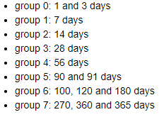
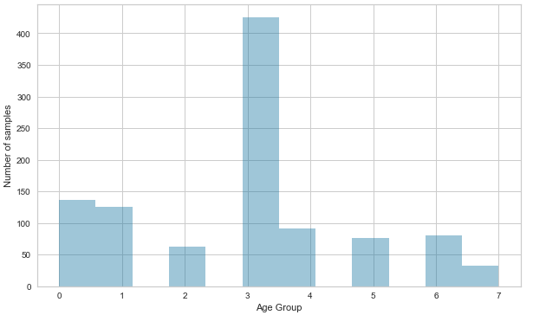
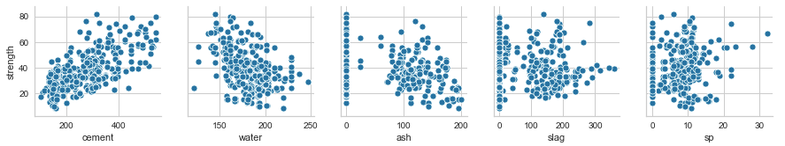
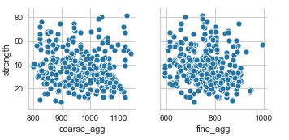
Data Exploration
Input Variables:
Cement (kg/m³)
Blast Furnace Slag (kg/m³)
Fly Ash (kg/m³)
Water (kg/m³)
Superplasticizer (kg/m³)
Coarse Aggregate (kg/m³)
Fine Aggregate (kg/m³)
Age (days)
Output Variable
Compressive Strength (MPa)
Relationships between strength and ingredients at 28 days
Notes:
Dataset information:
1030 instances (small dataset)
8 quantitative input variables, one quantitative output variable
no missing attributes
We show on this page the relationship between ingredients and strength at 28 days age

Slide 3
Data Preparation

Slide 4
Linear Regression

Slide 5
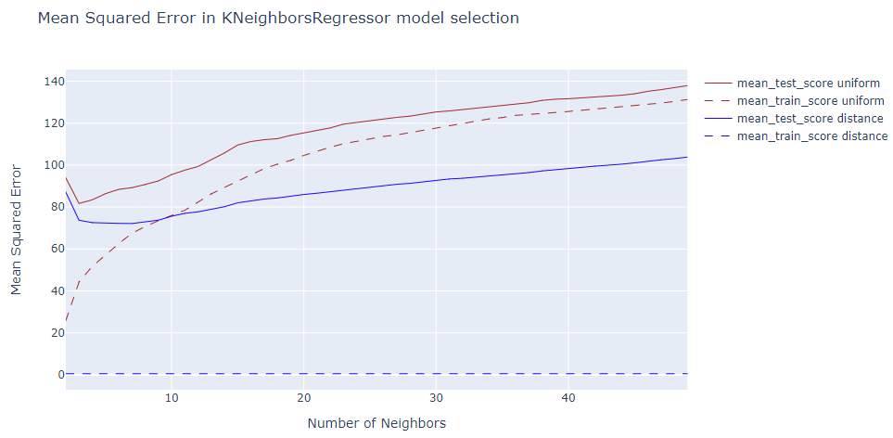
K Nearest Neighbors Regression
Model Parameters
number of neighbors: 7
weights: distance
Prediction Errors:
rmse: 9.155
mae: 6.542

Slide 6
Random Forests Regression

Slide 7
Conclusions

